Slide 1
Employee Data Analysis using Excel
STUDENT NAME:E.SEETHA
REGISTER NO:E34C8226F3924E4A24541B0C8C0C44F7
DEPARTMENT:B COM(COMMERCE)
COLLEGE:QUE QUEEN MARY'S COLLEGE

Slide 2
PROJECT TITLE
Employee Recruitment Analysis using Excel

Slide 3


AGENDA
Problem Statement
Project Overview
End Users
Our Solution and Proposition
Dataset Description
Modelling Approach
Results and Discussion
Conclusion
3/21/2024 Annual Review

Slide 4

PROBLEM STATEMENT
This project will indicate the status of having a Recruitment
This project is based on how many people applied for the job and select the job

Slide 5

PROJECT OVERVIEW
.This project includes are recruitment of data.In
Interviews give you a chance to talk about your work experience and notable educational qualifications. You can use this opportunity to show why you are suitable for the open position. You can also mention the positive attributes of your personality while answering interview questions

Slide 6

WHO ARE THE END USERS?
The end users of recruitment are primarily the hiring managers and team leaders who ultimately select and work with the candidates hired. However, there are other key stakeholders in the recruitment process, including:Candidates/Job Seeker,Recruiter HR,Professionals,Organizational Leadership,Onboarding Team,Employees Team members

Slide 7

OUR SOLUTION AND ITS VALUE PROPOSITION
Pivot table-Employee Name,Job title,Status and grand total
Chart-Bar chart

Slide 8
Dataset Description
Employee recruitment dataset -Kaggle
Features -8
Employee name, Job title
Status,grand total

Slide 9

THE "WOW" IN OUR SOLUTION
Employee recruitment data solution stand out,focuses On interactive dashboard ,advanced sualisation,predictive analysis and a users friendly interface.
3/21/2024 Annual Review
9

Slide 10
MODELLING
DATA COLLECTION
1.Determine the purpose :Collecting the data whether for recruitment selection etc
2.Data points:Em Employee name,Employee ID,job title,training type,Education,status.
10

Slide 11
Pivot table
1.prepare the data
2.select the data
3.Insert the pivot table :In exExcel go to the insert tab and click on pivot table report to be placed a new work sheet
4.set up your pivot table :Rows -employees name,column -Job title
5.Analyse your data :use the pivot table to quickly summaries and analyse recruitment data.
Chart Graph
1.collect data gather the data on wmpemployees name , job title
and status
2.choose a bar chart:usef useful for comarparing job
3.Create the chart:Customize the chart with title ,labe labels and colour to enhance readability.
Analyse use the chart to analyse and comparison job status.

Slide 12
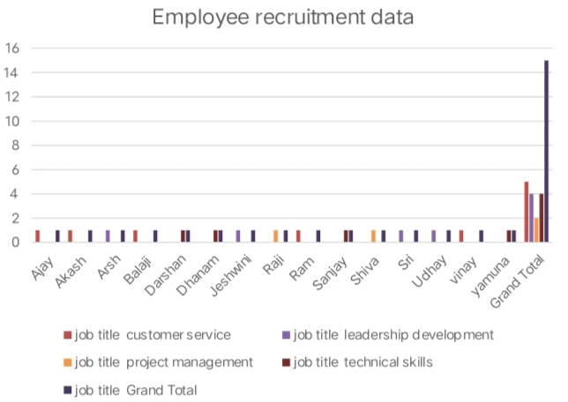
RESULTS
12

Slide 13
conclusion
Recruitment is the overall process of identifying, sourcing, screening, shortlisting, and interviewing candidates for jobs (either permanent or temporary) within an organization. Recruitment also is the process involved in choosing people for unpaid roles.

